Slide 1


Slide 2

CarWash

Slide 3
Group Member Introduction
Group ID: F24PROJECT72E6E
Name: Adeel Ahmed
ID: BC210406443

Slide 4
Introduction of Project
The CarWash Management System is a web application that helps car wash businesses manage their daily operations more easily. It allows admins to handle user accounts, services, bookings, inventory, and payments all in one place. Instead of using manual methods like paperwork or phone calls, the system makes everything faster, more organized, and available online.
For customers, the system provides a simple and friendly way to explore different car wash services, book appointments, and make payments securely. Customers can also create their own accounts, view their booking history, receive notifications, and give feedback after using the services. This helps build better communication between the business and its customers.
Our main goal with this project is to improve the efficiency of car wash businesses and to give customers a smooth and easy experience. By using this system, businesses can grow faster, reduce errors, and offer better service, while customers enjoy a more convenient and satisfying way to take care of their car wash needs.

Slide 5
VU Process Model Diagram

Slide 6
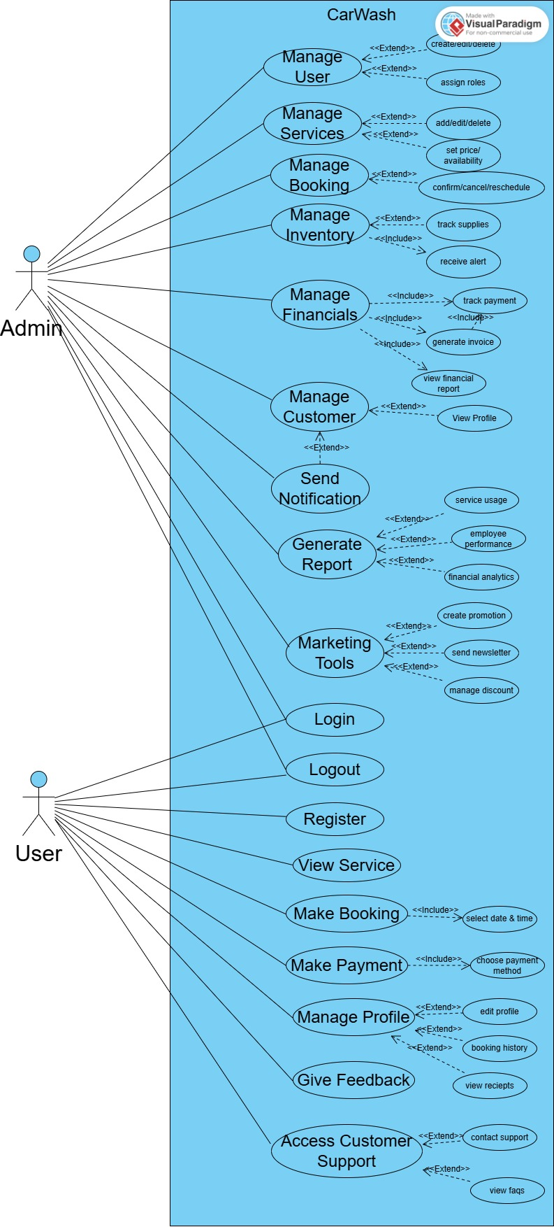
Use Case Diagram

Slide 7
Business Rule Catalog
Admin side:
User management:
Service management:
Booking management:
Inventory management:
Financial management:
Customer management:
Reporting:
Marketing tools:
Admin side:
User management:
Service management:
Booking management:
Inventory management:
Financial management:
Customer management:
Reporting:
Marketing tools:

Slide 8
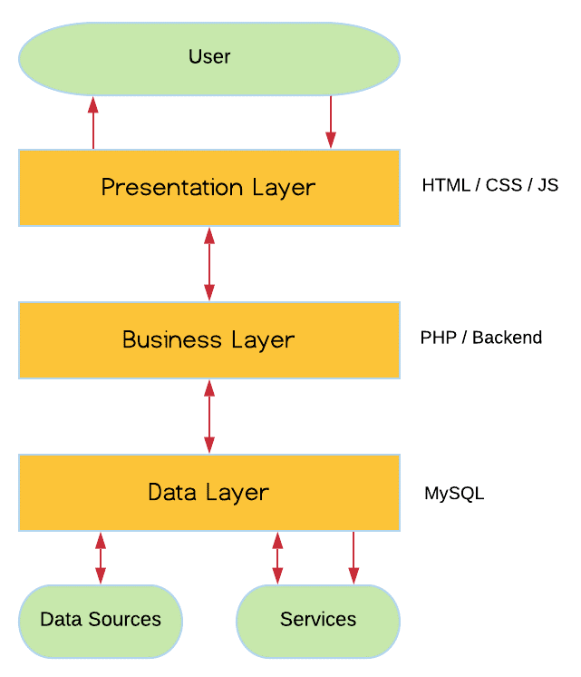
Architecture Diagram

Slide 9
Project Schedule

Slide 10
Sequence Diagram
Login

Slide 11
Sequence Diagram
Register

Slide 12
Sequence Diagram
Manage User

Slide 13
Sequence Diagram
Manage Service

Slide 14
Sequence Diagram
Manage Booking

Slide 15
Sequence Diagram
Generate Report

Slide 16
Sequence Diagram
View Service

Slide 17
Sequence Diagram
Send Booking

Slide 18
Sequence Diagram
Manage Profile

Slide 19
Sequence Diagram
Search Service

Slide 20
Sequence Diagram
View Notification

Slide 21
Sequence Diagram
Give Feedback

Slide 22
Sequence Diagram
Logout

Slide 23
Logical Model/ Class Diagram

Slide 24
Entity Relationship Diagram

Slide 25
Database Diagram

Slide 26
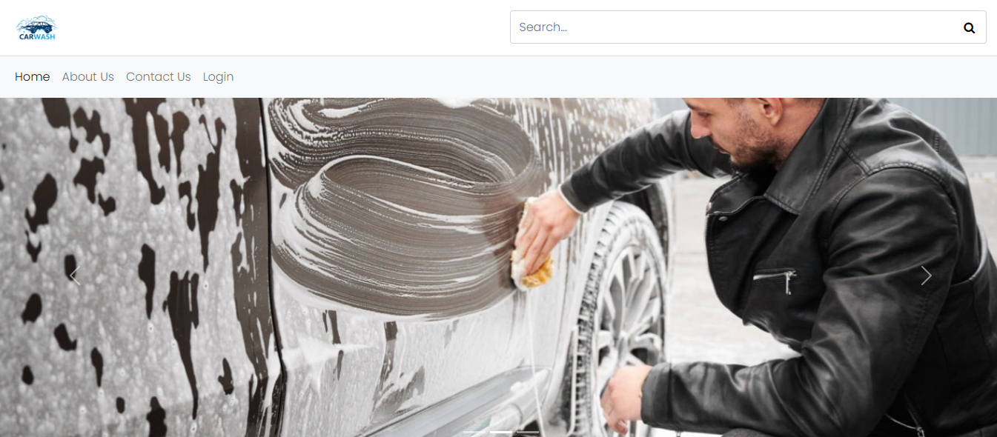
User Interface
Homepage

Slide 27
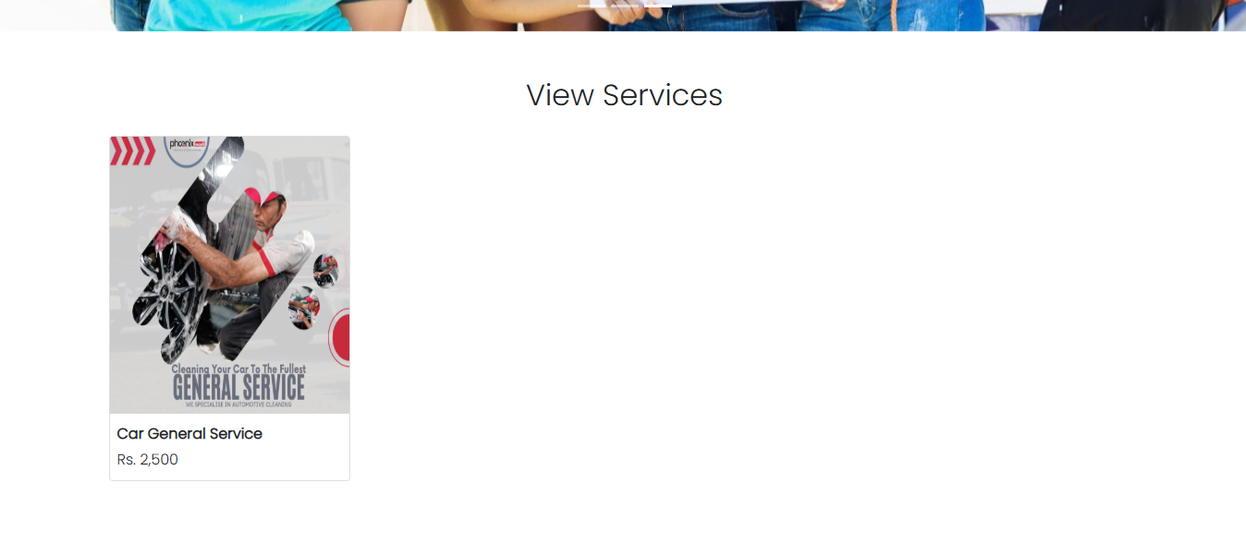
User Interface
View Service

Slide 28
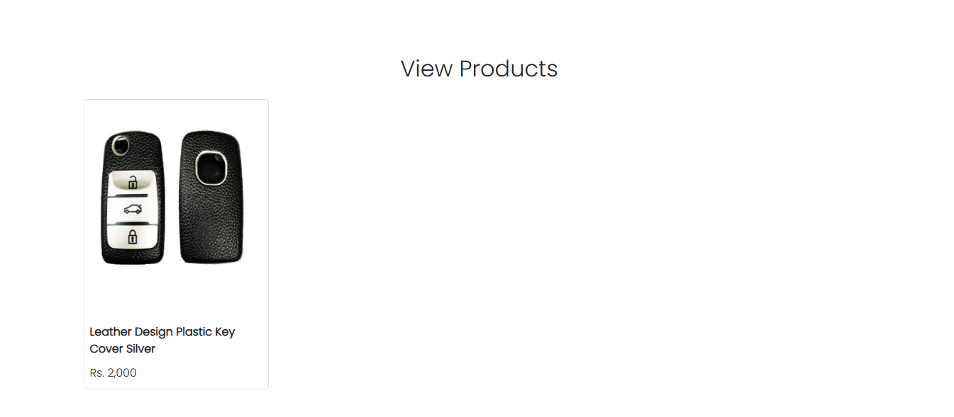
User Interface
View Products

Slide 29
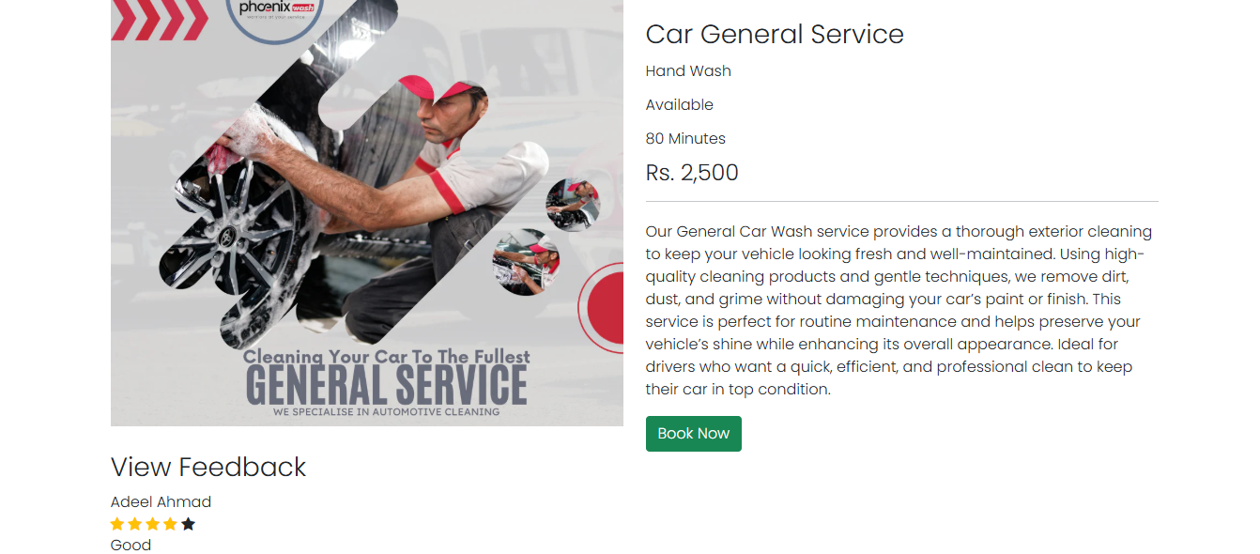
User Interface
View Service Detail

Slide 30
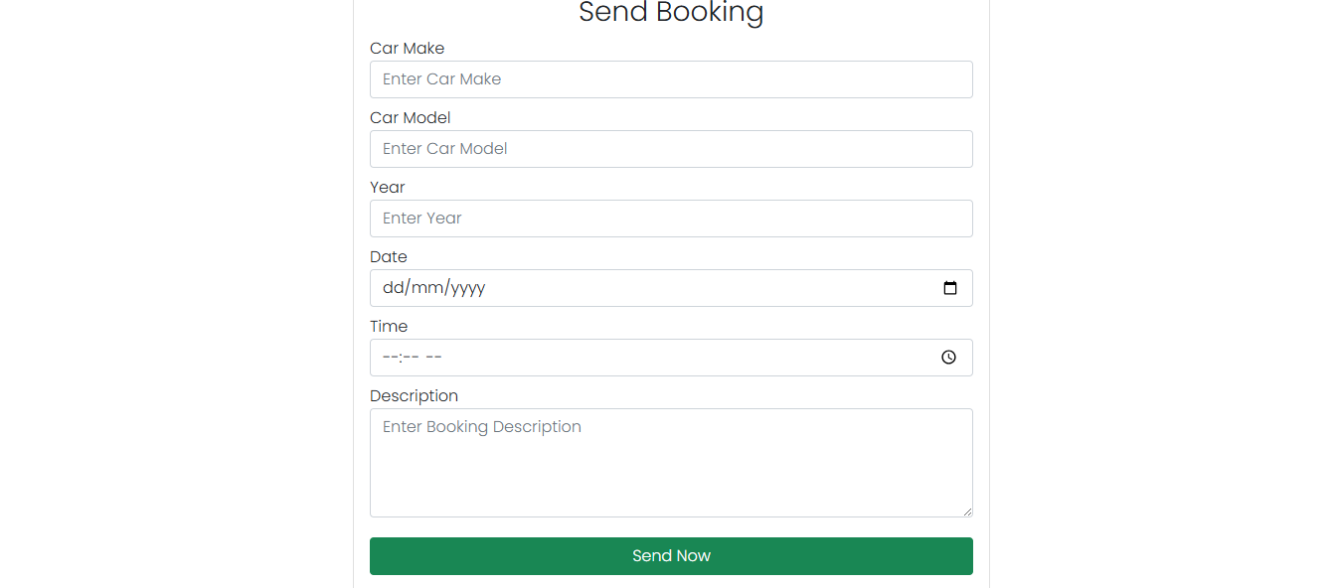
User Interface
Send Booking

Slide 31
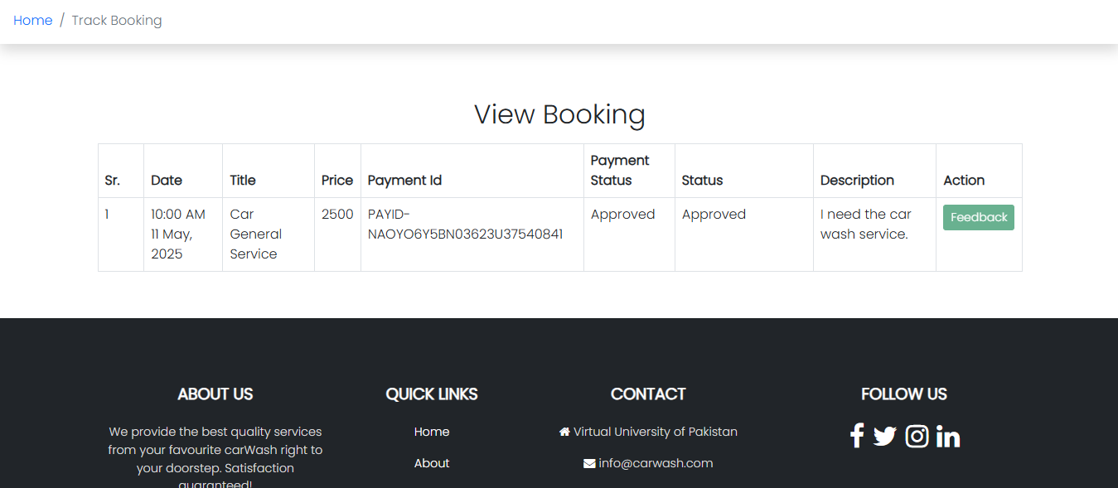
User Interface
View Booking

Slide 32
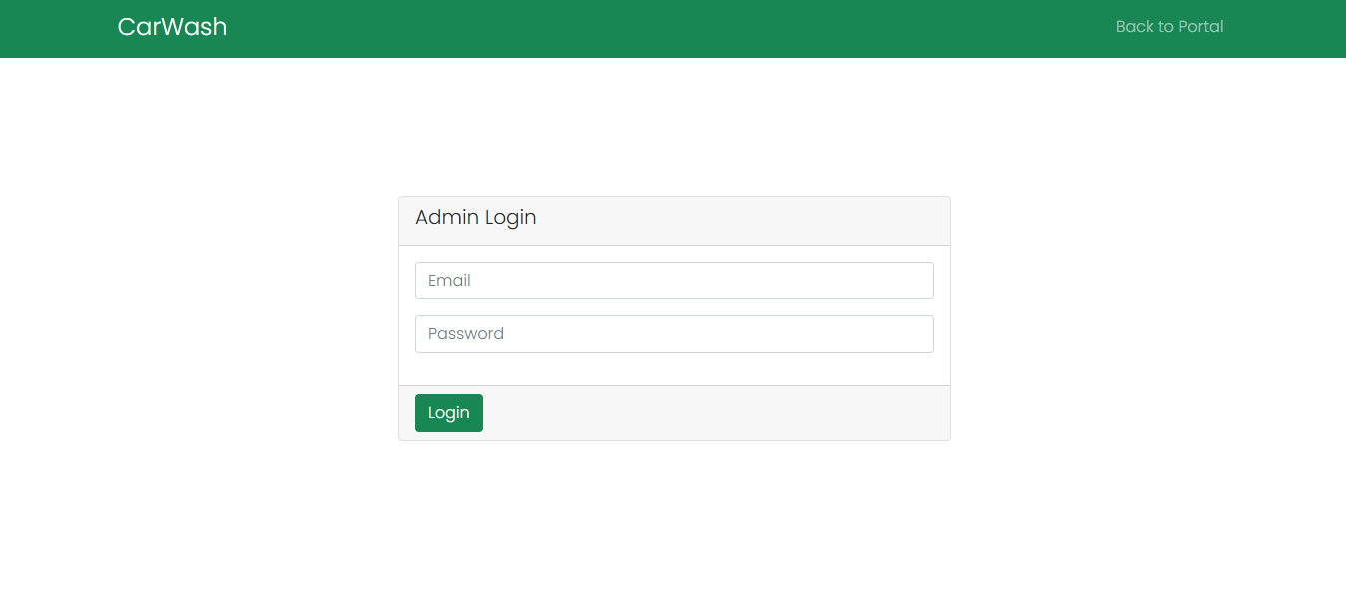
User Interface
Admin Login

Slide 33
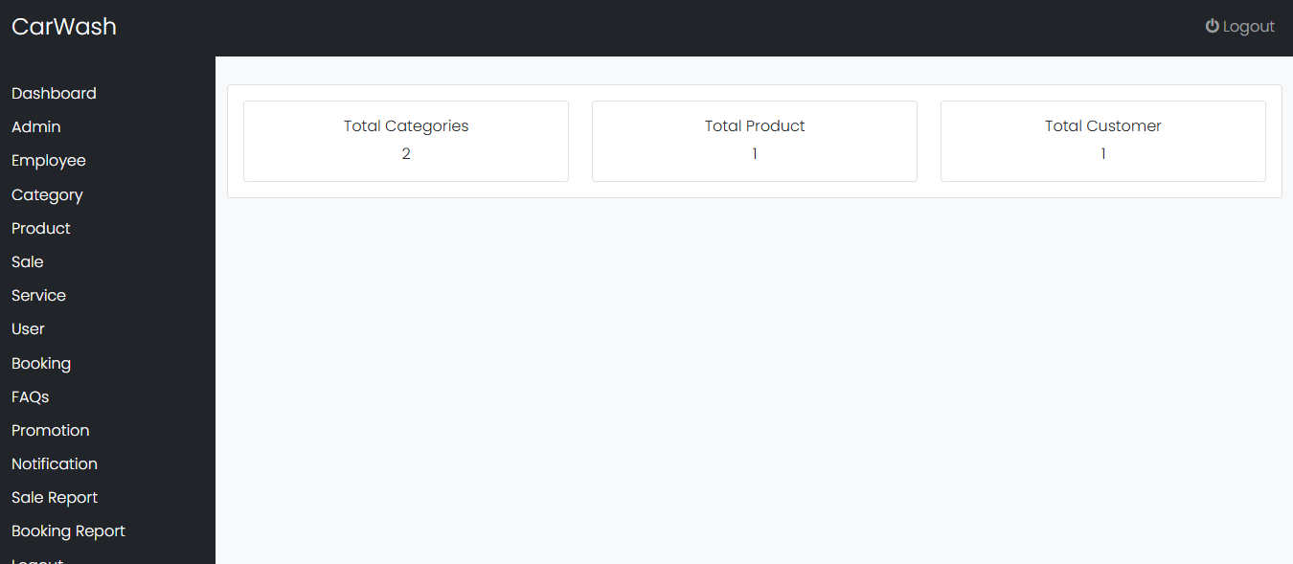
User Interface
Admin Dashboard

Slide 34
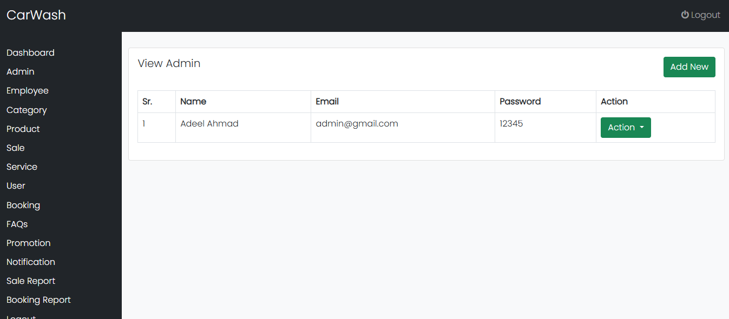
User Interface
Manage Admin

Slide 35
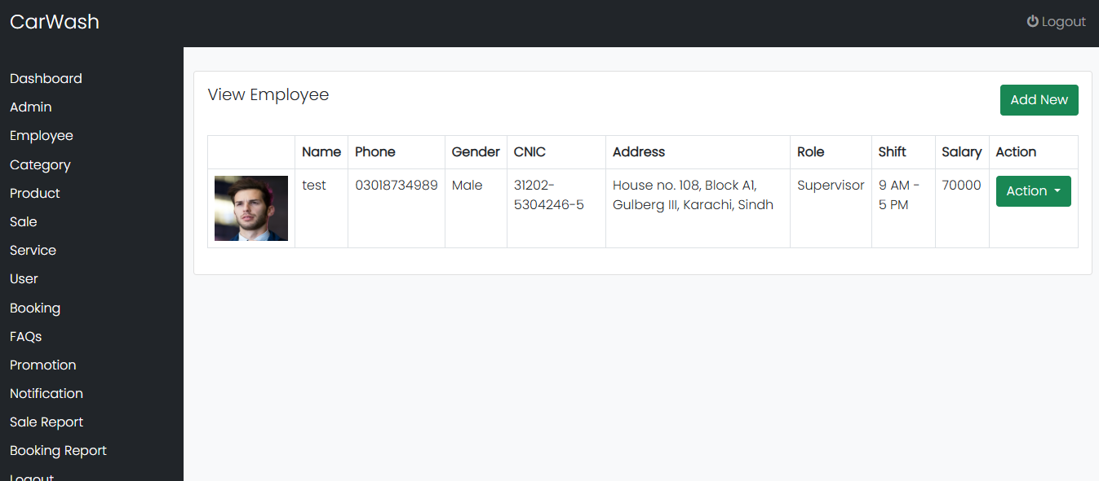
User Interface
Manage Employee

Slide 36
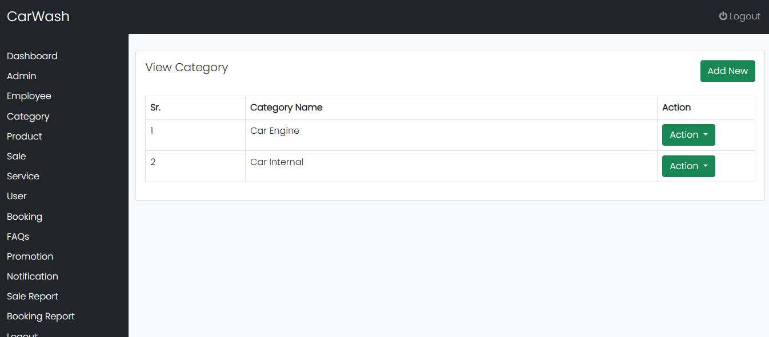
User Interface
Manage Category

Slide 37
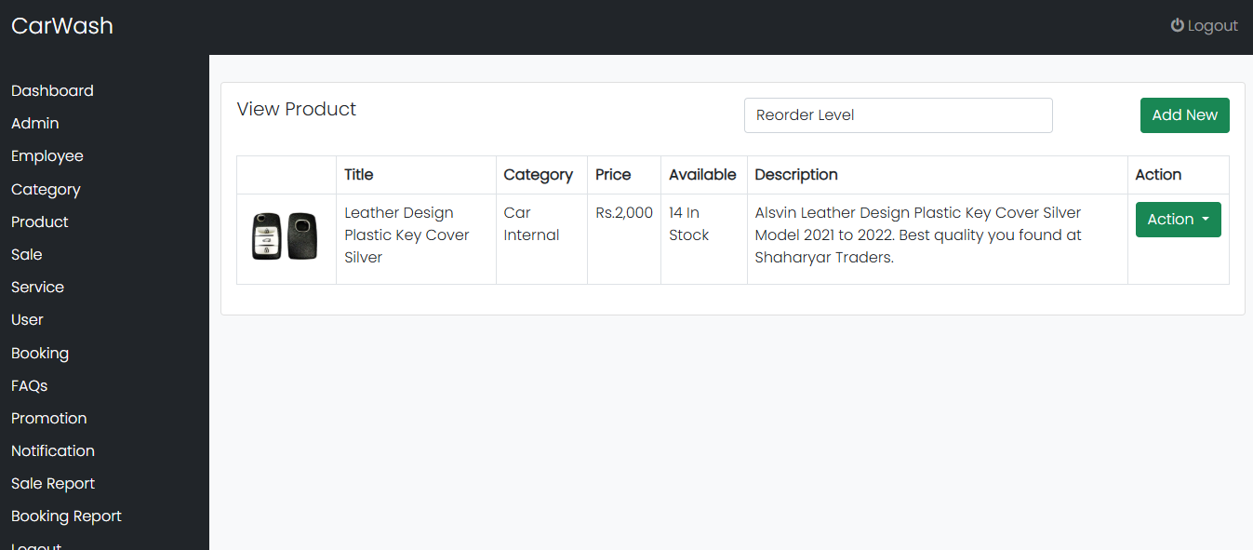
User Interface
Manage Product

Slide 38

User Interface
Manage Service

Slide 39
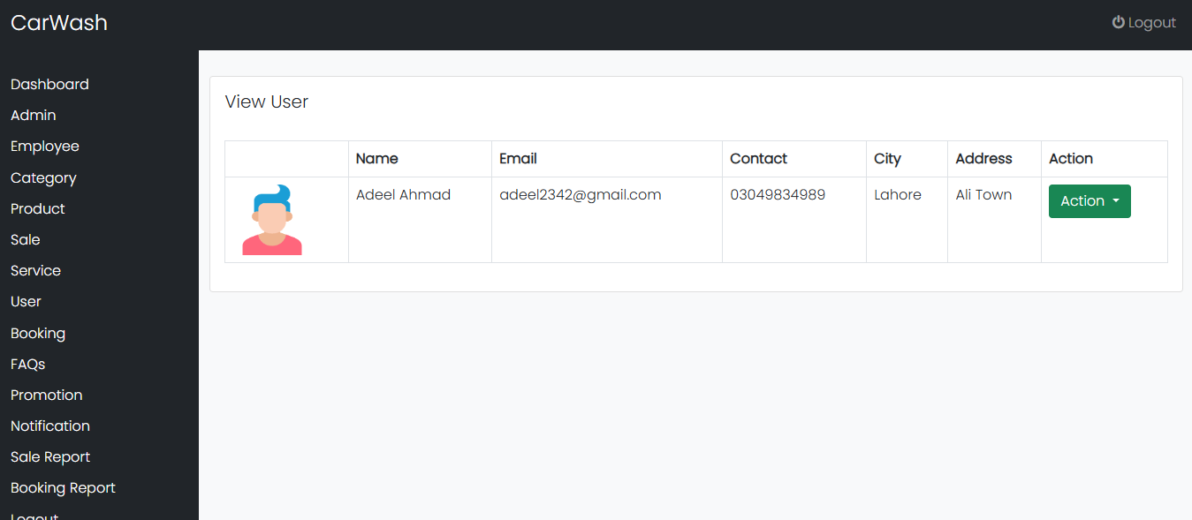
User Interface
Manage User

Slide 40
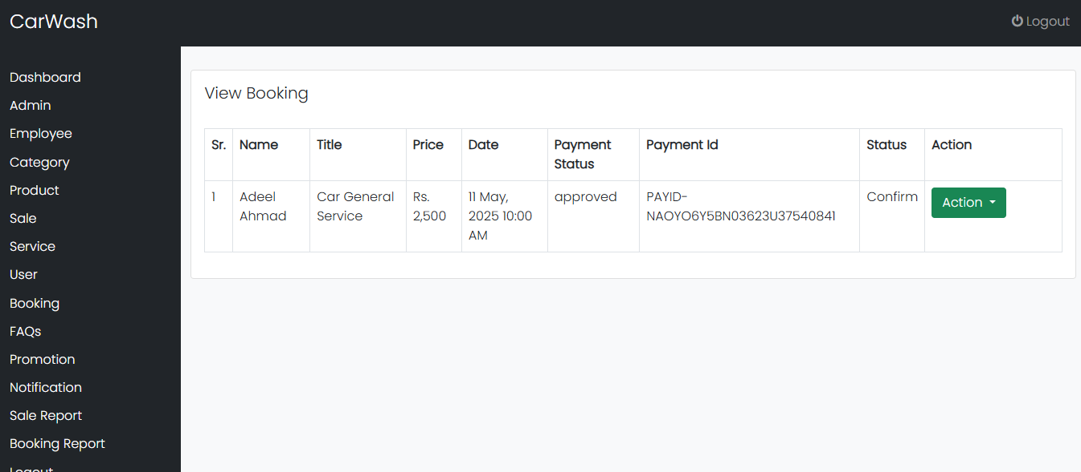
User Interface
Manage Booking

Slide 41
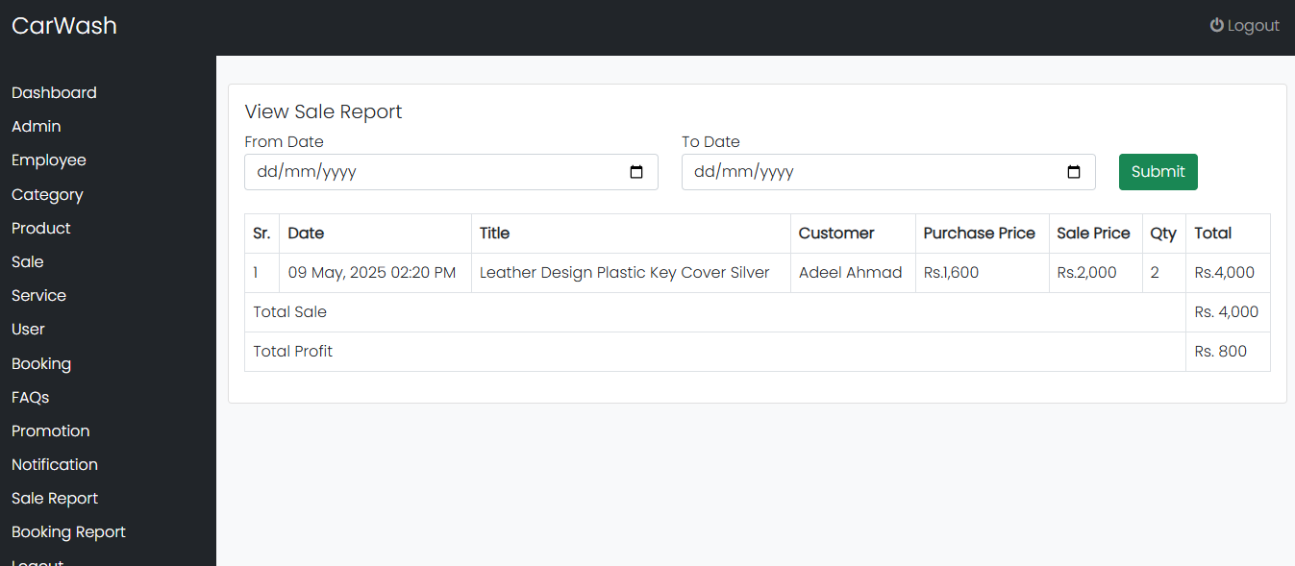
User Interface
Generate Report

Slide 42
Tools & Technology
Technologies:
HTML
CSS
Bootstrap
JavaScript
PHP
MySQL
Tools:
Notepad
Notepad++
Adobe DreamWeaver
Web Browser
Xampp Server

